Slide 1
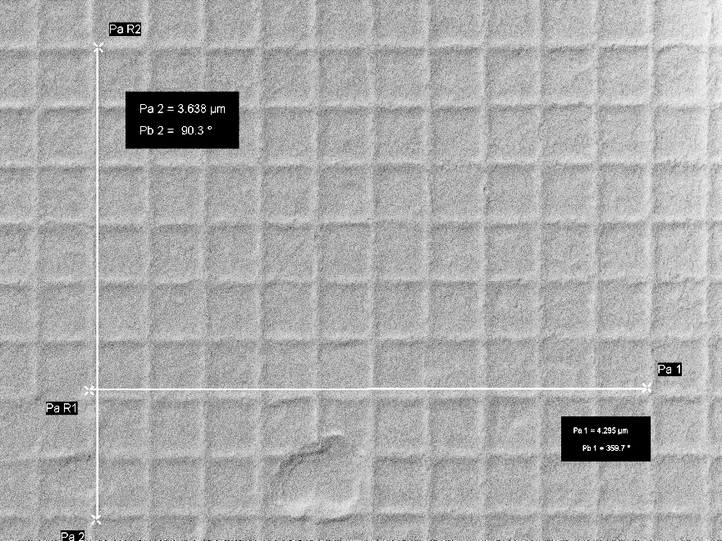
LEO 1530 SEM Magnification Calibration Results, Mar 2022
Voltage/ Direction | Magnification 1000X | Magnification 10Kx | Magnification 50 Kx | Magnification 100Kx
@ 5 kV Horizontal Vertical | -6.3% - 3.3% | -6.7% -4.3% | -9.5% -3.5% | -9.1% -5.7%
@15 kV Horizontal Vertical | -6.3% -2.5% | -6.0% -3.5% | -7.3% -1.7% | -6.5% -3.8%

